Slide 1
Hi guys
Please download today’s starting files at
https://chesnot.moe/start.zip
And extract the files.
I forgot my presenter so I’m going back to take it.
We start at 7:15.
Today’s session is going to be looooooooooooooooong
As long as longcat on the left

Slide 2
3DC Web Development Series
Part 3 – (A very long) Introduction to Javascript

Slide 3
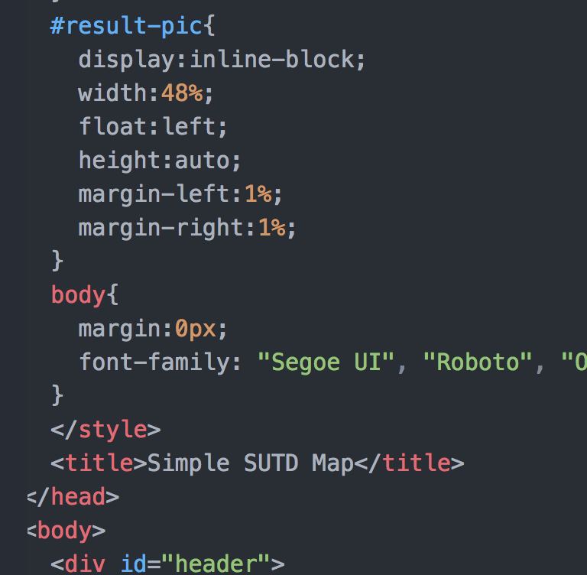
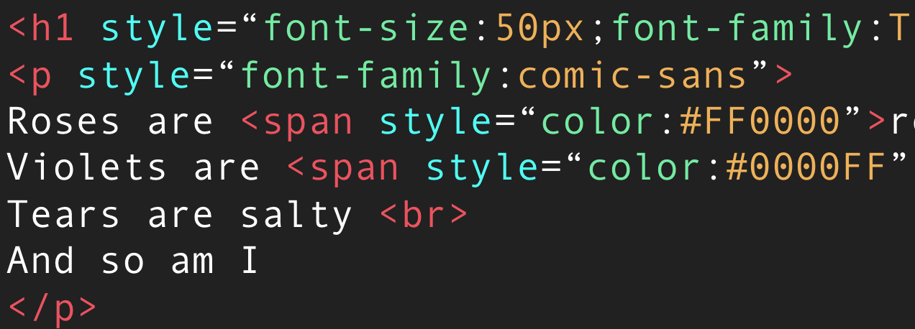
Continuation from last week - CSS
Remember the different ways to add CSS to your documents?
?
Inline CSS
Internal Stylesheets

Slide 4
External Stylesheets
To make your main .html file cleaner, you can move your CSS code to another file, called an external stylesheet.
The <style> tag in the header is then replaced with:
<link href=“folder/mysheet.css” rel=“stylesheet”/>
Self closing tag
The path (href) is set relative to the current html file.

Slide 5
Javascript
Javascript is a fully featured programming language that can be run before and/or after the page loads
Besides the mathematical computation stuff like what Python can do, it also lets you modify the webpage when certain events are fired (e.g. mouseclicks)

Slide 6

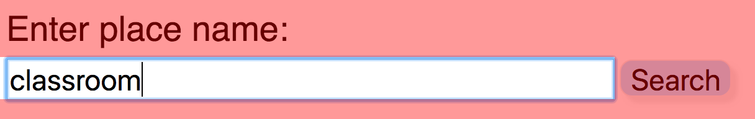
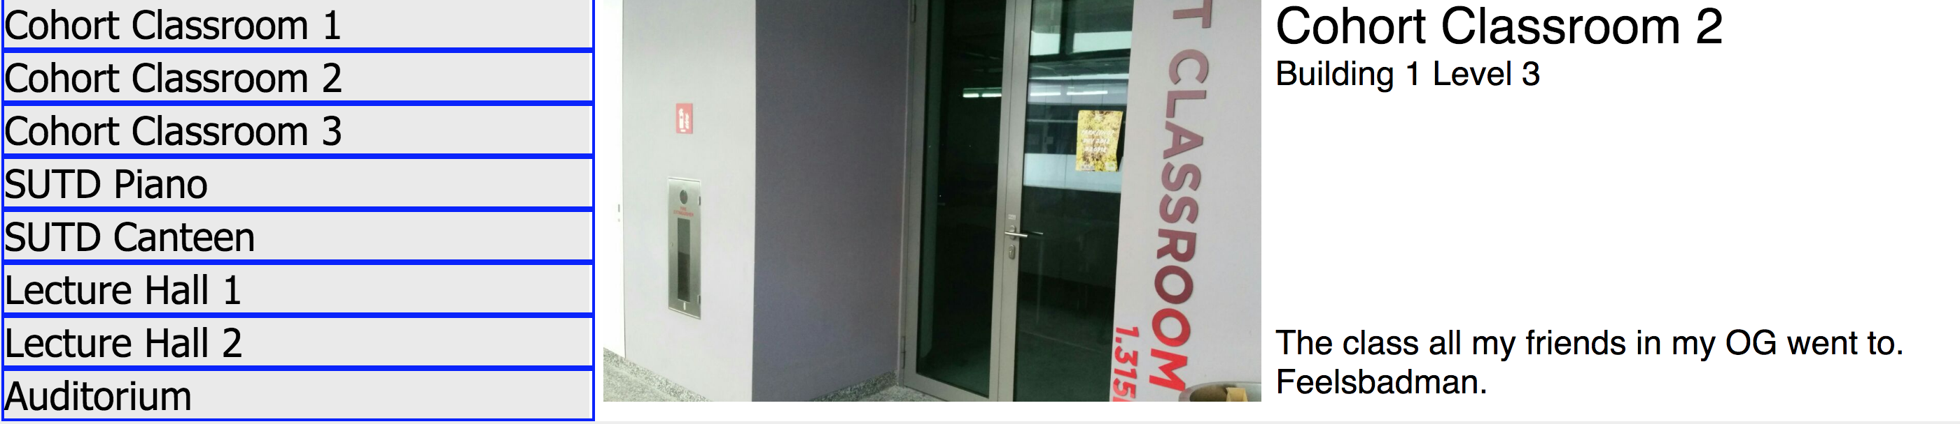
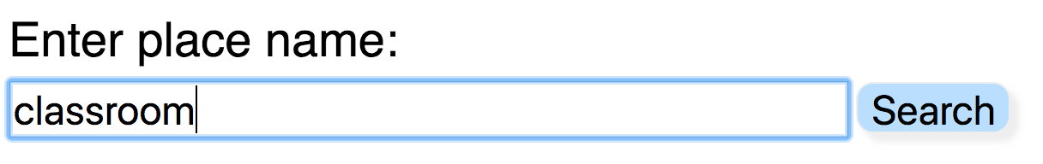
Activity Cycle of a Simple Webapp
Javascript analyses the state of the current document
e.g. retrieve the search term in the box
Javascript processes the inputs and produces suitable output
DOM Manipulation
Event fired
(click)
Wait for
Search button is pressed
next event
Javascript presents the output by creating new elements or modifying existing elements

Slide 7
Javascript – where to place
Javascript code is placed within <script> tags.
This <script> tag can then be placed in the <head> or the <body>, with advantages and disadvantages for each placement.
If placed in the <head>, it will run before the page elements are loaded.

Slide 8
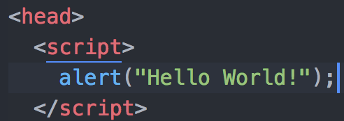
Your first Javascript code
Inside the <head> tag, create a <script> tag and type alert(“Hello World!”); inside.

Slide 9
What Javascript consists of
Like most programming languages, the average Javascript code is made of:
Function calls – tells the browser to perform specific actions
Variable definitions – tells the browser to “remember” some data for later use
Arithmetic operations – 4 + 5 = ⑨
Control structures – Only execute certain actions if some conditions are met

Slide 10
How functions are called
Javascript has some predefined function names such as alert
To invoke (call) these functions, you write the function name followed by parentheses ()
When you call functions, whatever goes inside the brackets are called arguments (sometimes called parameters)
Arguments are data you pass into a function for the function to manipulate, just like math.
f(x)
alert(“Hello World”);
Function name
argument
Function name
argument

Slide 11
Functions - continued
Functions can return values (like math), but can also return nothing
Functions can take multiple arguments/parameters (like math), but can also accept nothing
Math.max(100, givenInteger);
function name
argument 1
argument 2
window.refreshCurrentPage();
function name

Slide 12
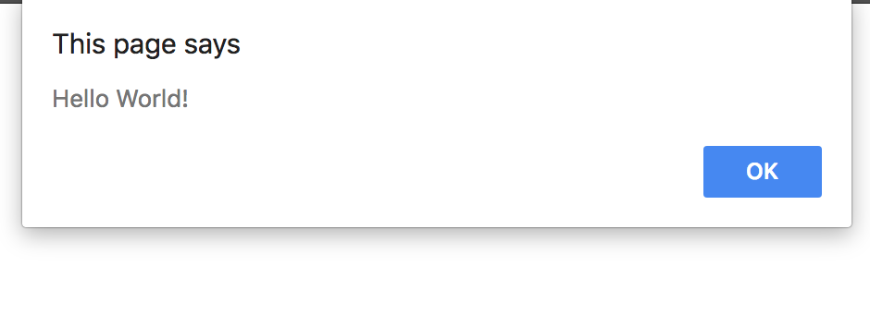
The alert function
A simple function that takes one argument
Tells the browser to displays a system dialog box with contents being what was passed into the function call as an argument
alert(“Hello World”);
Function name
argument

Slide 13
“Composite functions”
Actually called “command substitution”
You can use the output of a function / expression as the input of another function, just like math.
g(x+1)
alert(1+1);
g(f(x))
alert(“hello”.toUpperCase());
alert(Math.random());

Slide 14
Variables
Like math, you can arbitrarily create variables for yourself to store data for later reference.
Variable names can consist of letters, numbers, dashes and underscores, but can only begin with a letter.
var myNumber = 100;
alert(myNumber);
Variable names are case sensitive.
You only need to use the keyword var when defining it for the first time.

Slide 15
The Assignment Operator
The value of a variable can be changed with the = operator.
When manipulating variables with other operators (+ - * /) and expressions, the value is not changed unless you assign it with the = operator.
var myNumber = 100;
alert(myNumber + 100);
alert(myNumber);
var myNumber = 100; alert(myNumber);
myNumber = myNumber + 100 alert(myNumber);

Slide 16
Variable Types
Unlike math, numbers are not the only data type you’ll be dealing with in Javascript.
Besides numbers, you can manipulate strings (words), arrays (lists), HTML elements and pretty much any abstract object you can come up with.
Different data types have different properties, rules and functions available for use.
var myNumber = 100;
myNumber = myNumber + 10;
alert(myNumber);
var myName = “Bob”;
myName = myName + ” Tan”;
alert(myName);
Note how strings are enclosed in quotes.

Slide 17
String functions
String data types have built in functions for you to do certain operations to them.
These functions can be accessed by using a . after your string and can return a variety of different values depending on the function.

Slide 18
Dot notation
In JavaScript (and several other languages like python), an object’s functions (methods) and variables (properties) can be accessed with the . symbol.
speech.toUpperCase();
speech.indexOf(“hello”);
speech.length;
methods
properties

Slide 19
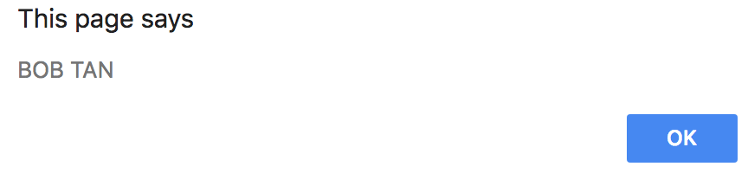
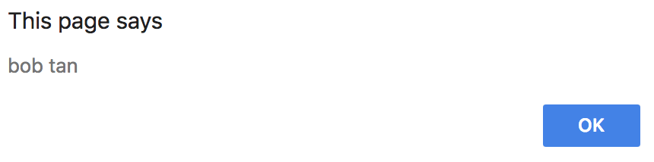
toUpperCase and toLowerCase
These functions return a copy of the uppercase and lowercase versions of your string, respectively.
var myName = ”Bob Tan”;
alert(myName.toUpperCase());
var myName = ”Bob Tan”;
alert(myName.toLowerCase());
Reminder: neither of these will modify the original myName variable because the = operator was not used.

Slide 20
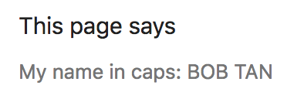
String concatenation
Strings can be combined (“concatenated”, or “concat” for short) using the + operator.
There is no - * / for strings.
var myName = ”Bob Tan”;
alert(“My name in caps: ” + myName.toUpperCase());

Slide 21
replace
The replace function replaces the first occurrence of a substring in a string with another string. (It returns a copy, it does not modify the original variable)
var speech = “I hate SUTD and I hate the people here”;
alert(speech.replace(“hate”,”love”));
//returns: I love SUTD and I hate the people here
To replace all occurrences, you’ll need to iteratively run the replace function until there is none left, which we will cover later.

Slide 22
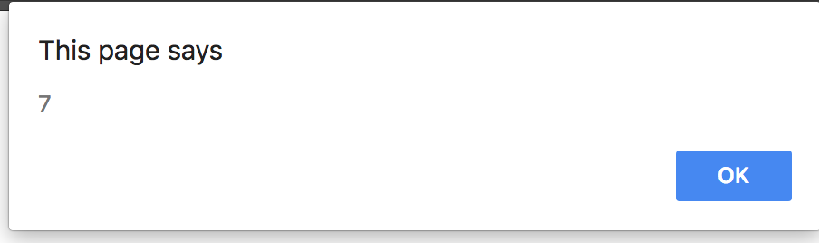
indexOf
Returns the position of the first occurrence of a substring within the original string.
var speech = “I like SUTD”;
alert(speech.indexOf(“SUTD”));
1 3 5 7 9
I like SUTD
0 2 4 6 8 10

Slide 23
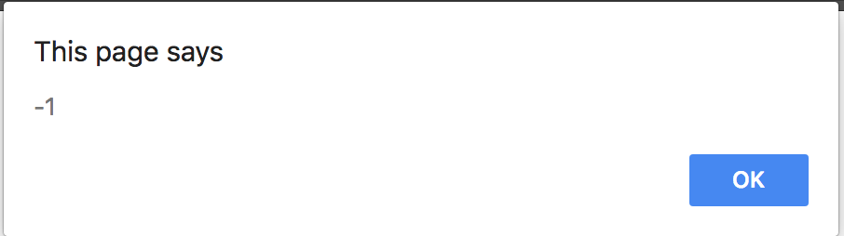
indexOf – cont.
The indexOf function will return -1 if the specified substring is not found.
var speech = “I like SUTD”;
alert(speech.indexOf(“NUS”));
Using this behaviour, we can use the indexOf function to determine whether the string contains another substring.

Slide 24
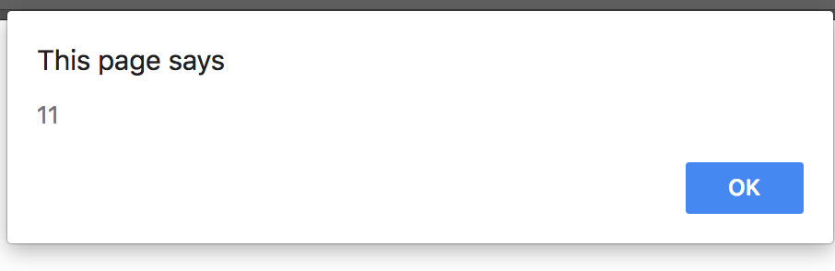
length
The length property gives you the length of the string.
var speech = “I like SUTD”;
alert(speech.length);

Slide 25
Activity Cycle of a Simple Webapp
Javascript analyses the state of the current document
e.g. retrieve the search term in the box
Javascript processes the inputs and produces suitable output
DOM Manipulation
Event fired
(click)
Wait for
Search button is pressed
next event
Javascript presents the output by creating new elements or modifying existing elements

Slide 26
Events & Event Listeners
Events are fired as the user interacts with the page.
Click, mouseover, mouseout, keypress, scroll etc….
Event Listeners are user defined functions that will be called when a specific event is fired.

Slide 27
Event Listeners - onclick
One way of attaching event listeners to elements is via HTML attributes.
The onclick attribute will execute some JavaScript when the element is clicked.
<input type=“button” onclick=“someJavascript()”/>
Try adding alert(‘Hello!’) on the onclick attribute of the button.

Slide 28
Event Listeners - onclick
A cleaner way is to define your own function in JavaScript, then have the onclick event listener call that function.
<script>
function sayHello(){
alert(”Hello World!”);
}
</script>
<input type=“button” onclick=“sayHello()”/>
JavaScript in <head>
HTML in <body>

Slide 29
Accessing the DOM
The HTML Document is accessible to JavaScript code via the model called the Document Object Model (DOM)
Child elements and attributes are accessible via dot notation.
There are a variety of ways to select elements via JavaScript, but the most common one is using the element’s id.

Slide 30
getElementById
The most fundamental method for finding elements is the getElementById method.
document.getElementById(”search-bar”);
You can assign the return value of the function to a variable to easily access the element again later:
var searchBar = document.getElementById(”search-bar”);

Slide 31
.value
For <input> type elements, .value will give you what the user has entered into the input element.
var searchBar = document.getElementById(”search-bar”);
alert(searchBar.value);

Slide 32
Control Structures
Let’s try to make the following:
The user enters a search term into the search box
When the user presses the search button, use JavaScript to check if the search box is empty.
If empty, create an alert box to tell the user to type something.
How do we do this part?

Slide 33
Conditional Statements - if
We can use an if statement to control the flow of our JavaScript code.
Now, we will try to check if the search term is empty.

Slide 34
Writing if statements
The syntax for an if statement is as follows:
Conditional statement
if (searchBar.value.length == 0){
alert(“Type something in the search box!”);
}
actions
The code inside the if block will only be executed if the conditional statement evaluates to true.

Slide 35
Comparison operators
Inside the brackets, you can write a conditional statement using comparison operators
expr1 == expr2 //equals to
expr1 != expr2 //not equals to
expr1 <= expr2 //less than or equals to
expr1 < expr2 //less than
expr1 >= expr2 //more than or equals to
expr1 > expr2 //more than

Slide 36
Logical Operators
You can combine comparison statements with logical operators:
statement1 && statement2 //logical AND
statement1 || statement2 //logical OR
!statement1 //logical NOT
a == 1 && b == “apple”
Entire statement evaluates to true if and only if a equals 1 and b equals apple

Slide 37
Checking if the search bar is empty
A cleaner way is to define your own function in JavaScript, then have the onclick event listener call that function.
<script>
function search(){
var searchBar = document.getElementById(”search-bar”);
if (searchBar.value.length == 0){
alert(“Type something in the search box!”);
}
}
</script>
JavaScript in <head>
<input type=“button” onclick=“search()”/>
HTML in <body>

Slide 38
Doesn’t work very well…
If the user types all spaces, searchBar.value.length will return a non-zero value.
So how?

Slide 39
.trim()
Strings have a .trim() method to remove all whitespaces (spaces, tabs, newlines) from the beginning and the end of the string.
Now, can you modify the code to fix that bug?

